Slide 1
DEEP LEARNING aSSIGNMENT 2
problem 2
Lim Kai Chong S10226797J

Slide 2
TABLE OF CONTENTS
01
02
03
04
Problem and approach
Data processing and loading
Developing the models
Generating text
Problem definition, objective and approach
Loading and processing the text corpus
Developing the sequence generator models
Using the developed model to generate text

Slide 3
01
INTRODUCTION
Problem Definition, Objectives and Approach

Slide 4
OBJECTIVE:
Generate text by developing a sequence generator model using a text corpus
Notes:
The objective of this assignment is to generate text by developing a sequence generator model using a text corpus.

Slide 5



problem
Vectorized data
TRAIN MODEL
gENERATE TEXT
To serve as model input
By building a good model, better text will be generated
This is the end goal
Notes:
Based on the objective, the problem can be split into 3 parts. Firstly, data needs to be vectorized. Secondly, models will need to be trained so that lastly, we can achieve the end goal of generating text. By splitting the problem into these 3 parts, we can easily identify the approach that will be used

Slide 6
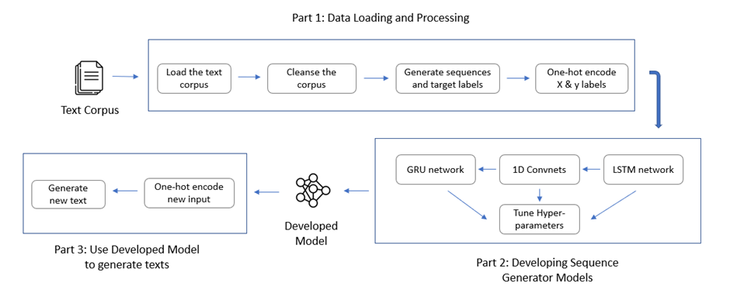
Approach
Data Processing | Loading, cleansing, sampling X and y labels and vectorizing the X and y labels
Develop Sequence Generator Models | Test out various architectures like the LSTM network, the GRU network and 1D Convnets
Use Model to Generate text | Record and encode user input, before feeding it to the developed model
Notes:
This is the approach. As you can see, the diagram here is included to help visualise the approach. For data processing, the text corpus will be loaded, cleansed, sampled into X and y labels and vectorized. Thereafter, the sequence generator models will be developed by testing out various architectures like LSTM, GRU and 1D convnets. In this part, the universal machine learning workflow will be closely followed as well, so that will mean starting with a baseline model, scaling up the model, tuning hyperparameters and et cera. Lastly, text will be generated by feeding encoded user input into the model.

Slide 7
02
DATA PROCESSING AND LOADING
Preparing the data
Notes:
With this, we can proceed to process our data

Slide 8
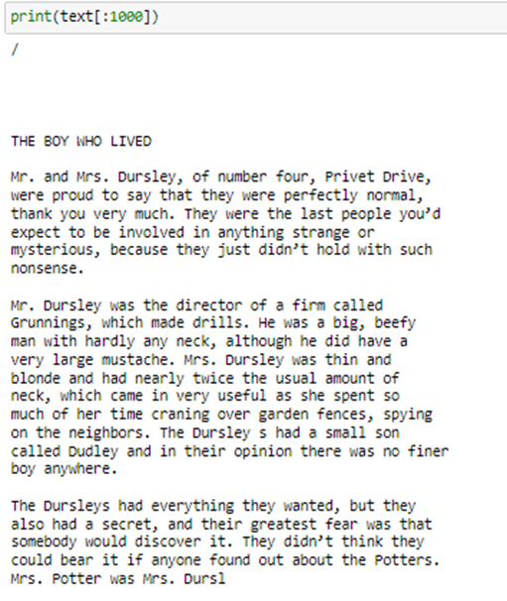
DATA LOADING - LOADING THE TEXT CORPUS
Loading the text corpus | Loading the text corpus obtained from the text file containing the text for Harry Potter and the Philosopher’s Stone Number of characters = 474429
Looked at the first 1000 words in the corpus | To get a sense of what the text corpus looks like/the structure of the text corpus A lot of empty spaces and redundant special characters like the ‘/’ symbol that do not contribute to the contextual semantics of the document
Notes:
First, the text corpus was loaded and from the text, we can see that there are a lot of empty spaces and redundant special characters like ‘/’ that do not contribute to the contextual semantics of the document

Slide 9
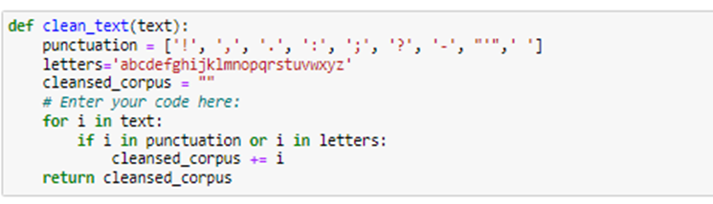
DATA LOADING - REDUCING THE VOCABULARY
By reducing the vocabulary | Removes noise in the data that could affect learning process, and cleanses the textual data
Notes:
Therefore, to remove noise in the data that could affect the learning process of the model, the vocabulary of the text corpus was reduced to cleanse the textual data by removing special characters

Slide 10
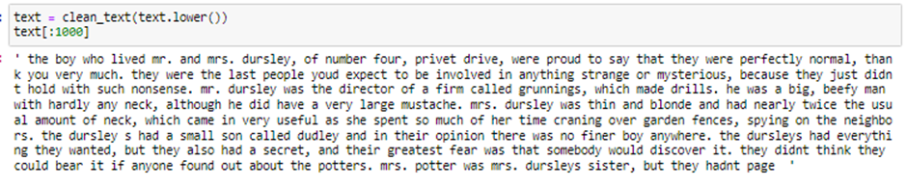
DATA LOADING - REDUCING THE VOCABULARY
After cleansing the text corpus | Less noise and redundant elements, reducing the vocabulary the network must learn
Notes:
After cleansing the textual data, we can see that there is less noise and redundant elements in the text

Slide 11
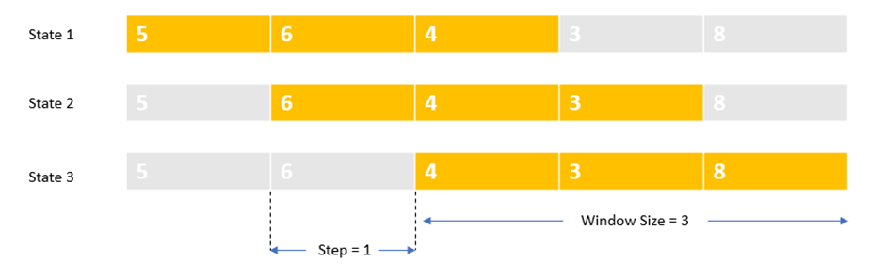
DATA PROCESSING - SLIDING WINDOW METHOD
Sliding Window Method | Used to analyse long chains of data and extract sequences
Notes:
Next, we process the data and sample them into X and y labels using the sliding window method. To summarise, this method is used to analyse long chains of data and extract sequences

Slide 12
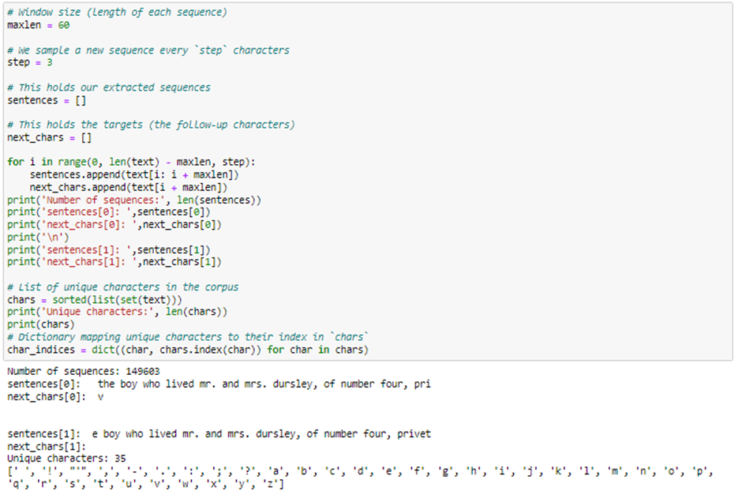
DATA PROCESSING - SAMPLING X AND Y LABELS
X Label: 60-character sequences
Y Label: Target characters at the end of each sequence
IN TOTAL:
149603 partially-overlapping sequences were extracted
35 unique characters/target labels
Notes:
Therefore, by using this method, we extract partially-overlapping sequences that are 60-character long as our X variable and target characters as our y variable. In total, 149603 sequences and 35 unique characters were extracted.

Slide 13
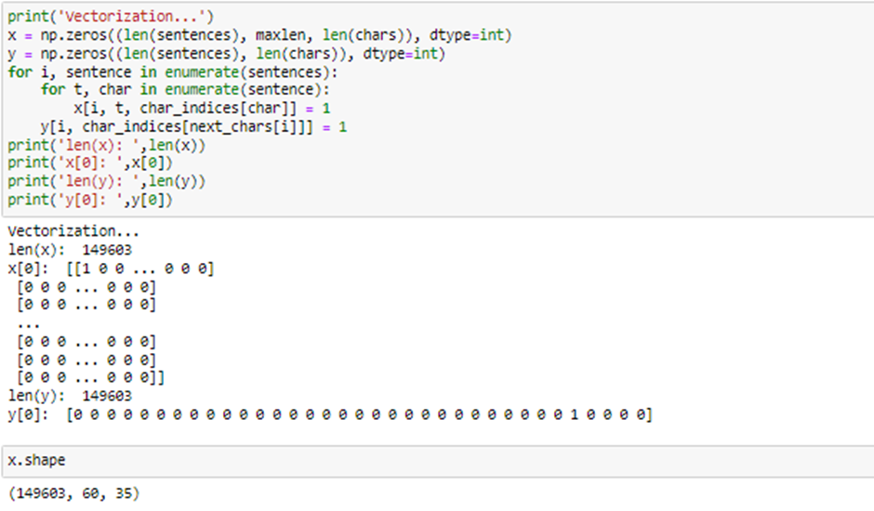
DATA PROCESSING - one hot encoding
One Hot Encoding:
Vectorises data to serve as model input
Process:
Converts the X and y labels to sparse vectors
Stores the outputs in a 3D NumPy Array
(149603, 60, 35) for X represents:
149603 extracted sequences
60 characters in each sequence
35 target labels
Notes:
Thereafter, one hot encoding was performed to vectorize data to serve as model input. This is done by converting the X and y labels to sparse vectors, and storing the outputs in a 3D numpy array

Slide 14
03
DEVELOPING SEQUENCE GENERATOR MODELS
Using LSTMs, GRUs and 1D Convnets
Notes:
With this, we can proceed to develop our sequence generator models

Slide 15
ARCHITECTURES THAT WILL BE EXPLORED:
LSTM Network
GRU NETWORK
1D Convnets
Long Short-Term Memory
Gated Recurrent Units
1D Convolutional Neural Networks
Notes:
In this section, 3 architectures that have been known to efficiently process temporal data will be explored, namely advanced RNN variants like the LSTM network and the GRU network, along with 1D Convnets. It is worth pointing out that because of the vanishing gradient issue, the SimpleRNN keras implementation would not be suitable for this task.

Slide 16
APPROACH TAKEN TO DETERMINE BEST MODEL
STEP 1: Tune weights | STEP 2: Tune Batch size and Optimizers | STEP 3: Reduce Overfitting
Hyperparameters involved: Recurrent Layers Recurrent Units Purpose: Increase accuracy Identify overfitting patterns based on magnitude of weights | Hyperparameters involved: Batch Size Optimization algorithms Purpose: Increase accuracy Identify overfitting patterns based on magnitude of weights | Hyperparameters involved: Recurrent Dropout Regular Dropout L2 Regularization Purpose: Reduce generalization issues Improve learning process and increase accuracy
Notes:
To briefly summarise how the best models were developed for each architecture, I used 3 steps. Firstly, I tuned the weights. Secondly, I tuned the batch size and optimizers and lastly, I reduced overfitting by testing different combinations of techniques such as recurrent dropout, regular dropout and L2 regularization.

Slide 17
GENERATING TEXT USING TEMPERATURE SAMPLING
Baseline Model | First epoch of final developed model | Last epoch of final developed model
Compare quality of generated texts for different model
Compare quality of generated texts as model converges
Notes:
Along the way, I also generated text using temperature sampling for the baseline model and the first and the last epoch of the final developed model. This is firstly to compare the quality of the generated texts for different models, and secondly to compare quality of generated texts as model converges.

Slide 18
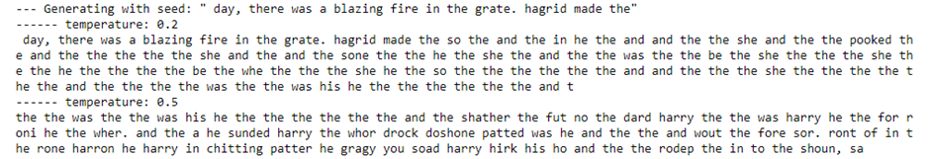
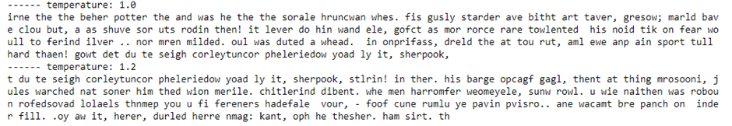
BASELINE MODEL - LSTM AND GRU
Lower temperature = More coherent; words that are actual English words Higher temperature = More interesting Given the accuracy of the baseline model (40%), not much meaning and interestingness in the generated text
Notes:
Just to give quick insights upon analysing the generated text, we can see that lower temperature usually results in more coherent sentences, whereas higher temperature results in more interesting sequences. However, in this case, given the accuracy of the baseline model, which is around 40%, not much meaning and interestingness could be seen in the generated text.

Slide 19
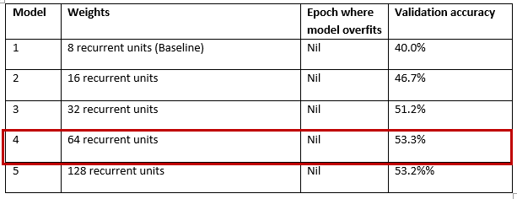
STEP 1: DETERMINE OPTIMAL WEIGHTS
Summary tables to record observations for each hyperparameter tuning process For recurrent units, 5 models were tested ranging from 8 hidden units for the baseline to 128 hidden units in Model 5 Best results will be brought forward and used in subsequent models In this case, Model 5 had the highest validation accuracy of 57.3% so 128 recurrent units will be used moving forward
Notes:
With this, we start to tune our hyperparameters. As you can see, for each step, summary tables were used to record observations, and the best results will be brought forward and used in subsequent models.

Slide 20
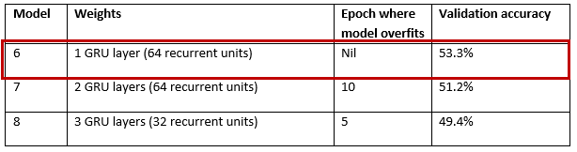
STEP 1: DETERMINE OPTIMAL WEIGHTS
For recurrent layers, 3 models were tested from a range of 1-3 layers Since difference in accuracy very minute + Model 6 was able to overfit later at a less-costly performance, 1 recurrent layer was used Therefore, for LSTMs, the optimal weights were determined to be 1 recurrent layer and 128 recurrent units
Notes:
To briefly summarise how I developed the best models for each architecture, I used 3 steps. Firstly, I tuned the weights to determine the optimal weights. Secondly, I tuned the batch size and optimizers and lastly, I reduced overfitting by testing different combinations of techniques such as recurrent dropout, regular dropout and L2 regularization.

Slide 21
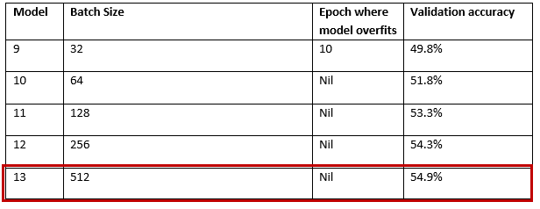
STEP 2: DETERMINE OPTIMAL BATCH SIZE AND OPTIMIZER
Similarly, batch sizes were tuned And in this case, a batch size of 128 achieved the highest validation accuracy
Notes:
Afterwards, the batch sizes and optimizers were tuned since in most cases, the optimal batch sizes and optimization algorithms vary from dataset to dataset and should be important hyperparameters to be tuned in any deep learning problem. Similar to the previous step, batch sizes were tuned using different values, in this case, a batch size of 128 achieved the highest validation accuracy.

Slide 22
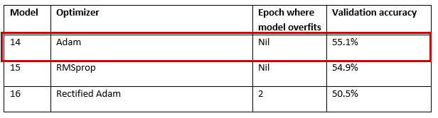
STEP 2: DETERMINE OPTIMAL BATCH SIZE AND OPTIMIZER
For optimizers, Adam, RMSprop and Rectified Adam were used Rectified Adam is a variant of the Adam optimizer whose learning rate is rectified This provides consistent variance and resolves issue of generalization faced by other adaptive learning rate optimizers like Adam As seen, RAdam was indeed able to resolve the issue of overfitting with RMSprop and Adam both overfitting before epoch 20, but because of its long learning process, Adam was able to achieve the highest validation accuracy of 57.6%
Notes:
Afterwards, the batch sizes and optimizers were tuned since in most cases, the optimal batch sizes and optimization algorithms vary from dataset to dataset and should be important hyperparameters to be tuned in any deep learning problem. Similar to the previous step, batch sizes were tuned using different values, in this case, a batch size of 128 achieved the highest validation accuracy.

Slide 23
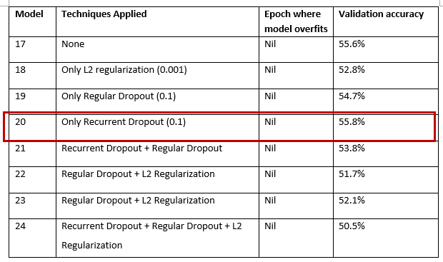
STEP 3: REDUCE OVERFITTING
A Recurrent Dropout at a value of 0.1 utilised was able to help in overfitting + increase accuracy to 58.3%, which is the highest accuracy thus far
Notes:
Afterwards, the batch sizes and optimizers were tuned since in most cases, the optimal batch sizes and optimization algorithms vary from dataset to dataset and should be important hyperparameters to be tuned in any deep learning problem. Similar to the previous step, batch sizes were tuned using different values, in this case, a batch size of 128 achieved the highest validation accuracy.

Slide 24
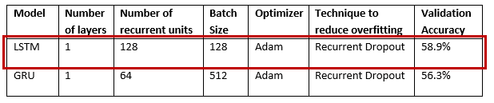
LSTM vs GRU
Upon making the comparison table, we see that the LSTM model manages to outperform the GRU model Therefore, the developed LSTM model will be the final developed model that will be used to generate text
Notes:
After repeating these steps across the LSTM and GRU models, we make comparisons between the developed LSTM and GRU model. From the table, we can see that the LSTM model manages to outperform the GRU model quite sizeably at a 3% increase in validation accuracy

Slide 25

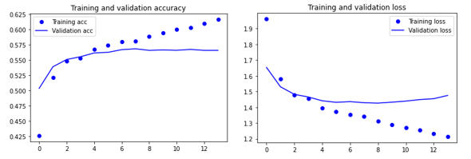
BIDIRECTIONAL LSTMS
As an experimentation, the LSTM layers of the LSTM model were replaced with Bidirectional LSTM layers to see if the implemental of Bidirectional traversal would help the model learn better Unfortunately, the results were not promising
Notes:
As an experimentation, the LSTM Layers of the LSTM model were replaced with Bidirectional LSTM layers to see if the implementation of Bidirectional traversal would help the model learn better. Unfortunately, as seen from the curves, the results were not promising

Slide 26
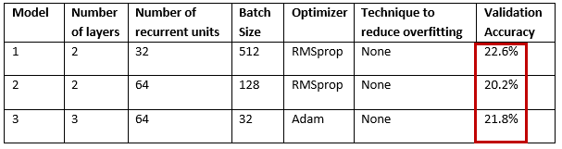
1D Convnets
Experimented with 1D Convnets as well but did not manage to produce promising results
Notes:
Lastly, I experimented with 1d Convnets as well but they did not manage to produce promising results across 3 models. Therefore, the LSTM model mentioned in the previous slide will be the developed language model that will be used for text generation

Slide 27
04
GENERATE TEXT
Generate 400-character sequences from input
Notes:
As mentioned, using the LSTM model, we generate text by recording user input

Slide 28
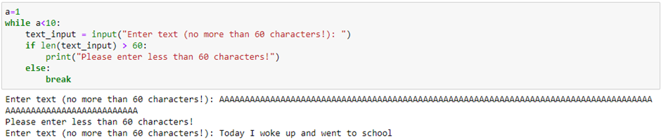
RECORDING USER INPUT
Input is recorded and validated to be shorter than 60 characters
Notes:
First, input is recorded and validated to be shorter than 60 characters

Slide 29
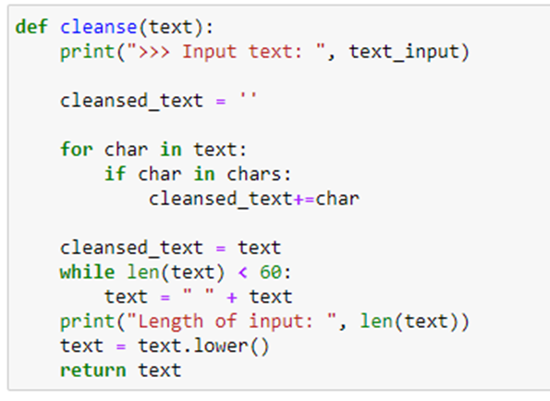
FUNCTION TO CLEANSE AND PAD USER INPUT
Thereafter, the input was checked to see if the characters exist in the vocabulary that the model was trained with Manual padding was implemented as well to ensure all inputs are 60-characters in length
Notes:
Thereafter, input is checked to see if the characters exist in the vocabulary that the model was trained with. Manual padding was also done to ensure all inputs are 60-characters in length

Slide 30
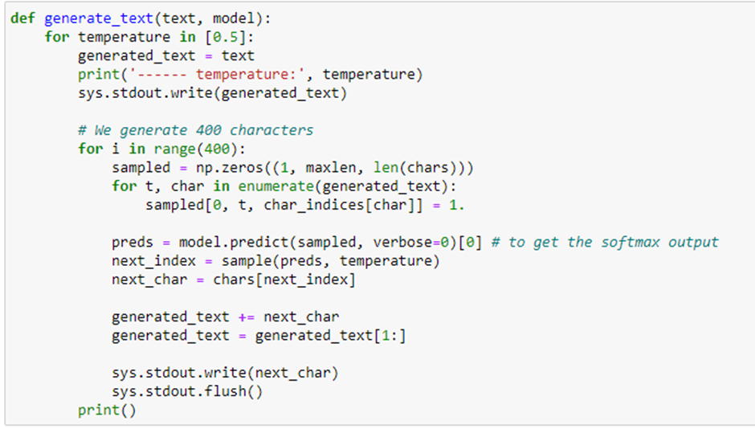
FUNCTION TO GENERATE TEXT
Next, a function to generate text was created In the function, 400 iterations were performed and in each iteration, input is encoded and a character is generated The character is then appended to the end of the sequence and the first character of the sequence is removed This process is repeated 400 times until a 400-character text is generated
Notes:
Next, a function to generate text was created. In the function, 400 iterations were performed and in each iteration, input is encoded and a character is generated. The character is then appended to the end of the sequence and the first character of the sequence is removed. This process is repeated 400 times until a 400-character text is generated

Slide 31
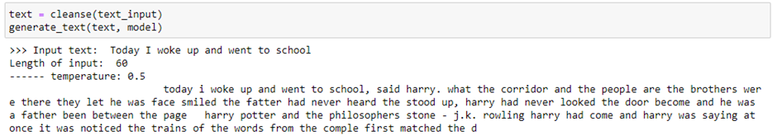
CLEANSING AND PADDING USER INPUT
In the generated text, we can see that the context is heavily based on the Harry Potter book, which is the corpus the model was trained using The sentences are semi coherent as well
Notes:
Lastly, we generate text using the functions. From the figure, we can see that the context is heavily based on the Harry Potter book, which is the corpus the model was trained with
The sentences are semi coherent as well

Slide 32
THANK YOU!
Notes:
With this, I have come to the end of my presentation. Thank you for listening to my presentation and I will now let my other groupmates take over

